Slide 1

WQD7005 Data Mining
The prediction of stock market helps investors in their investment decisions, by providing them strong insights about stock market behavior them strong insights about stock behavior to avoid investment risks.
https://youtu.be/h2I92hRIBGs

Slide 2



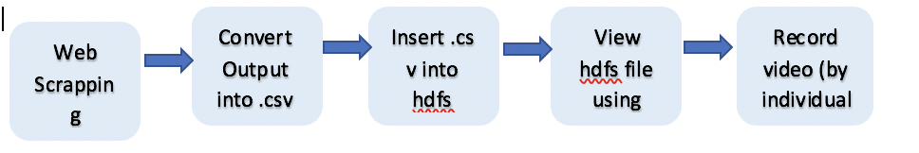
Data acquisition

Slide 3
DATA PROCESSING
In our assignment which we using two dataset
First dataset which we used to calculate PCA
Second dataset which we calculate SAX and PAA( time-series data )
Data preprocessing
a Create a sum column at the right known as “ Total” to sum all the stock values.
b Remove rows with sum value
c Replace NA with 0.000 in dataset

Slide 4
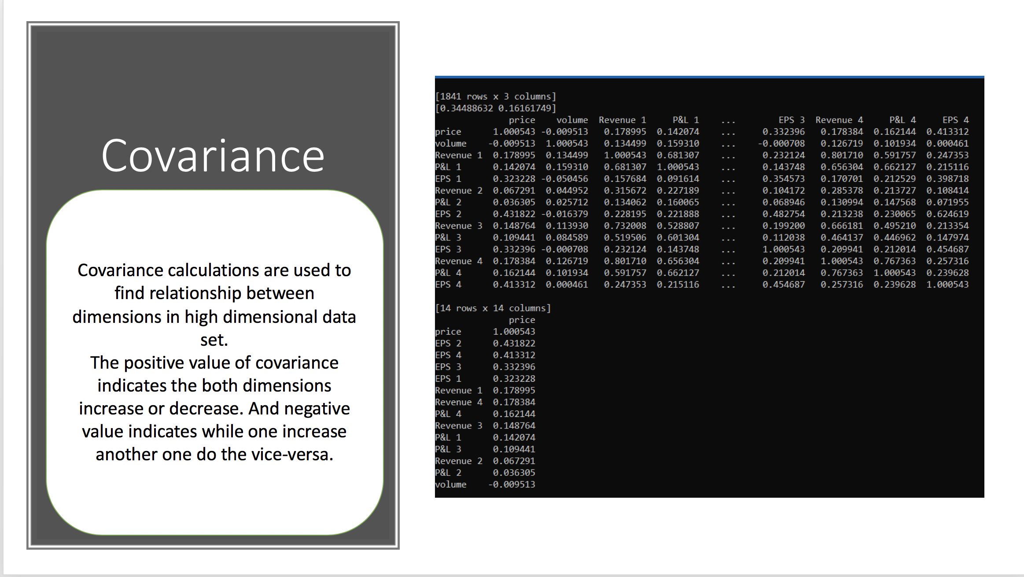

Slide 5
Proposed model
The proposed model helps investors avoid risks and financial crises when making investment decisions. The goal of the proposed model is to predict the stock market behavior, whether it is falling or raising.

Slide 6
Data Management
 | Google Big Query | Hadoop
Infrastructure | Serverless | Build on top of server and Network
On Premise | No (cloud as a service ) | Both Cloud and On Prem
Capacity | Petabytes | Petabytes
Database Support | Yes | SQL like interface
File Storage System | No | Yes
Distributed Processing | Database only | General Purpose, Structured and Unstructured data
Processing | Distributed, Realtime, Batch | Distributed, Batch
Data Types | Structured ( Row/Column ) | Structed and unstructured ( Data Lake)
Easy to setup and Use | Yes | Require physical setup of infrastructure on premise
SQL Query | Standard | Through eco system components, Hive
Search Speed | Very Fast for huge data | Very fast for huge data

Slide 7
Data warehouse
In computing, a data warehouse also known as an enterprise data warehouse, is a system used for reporting and data analysis, and is considered a core component of business intelligence. DWs are central repositories of integrated data from one or more disparate source. They store current and historical data in one single place that are used for creating analytical reports for workers throughout the enterprise.

Slide 8
Data warehouse
In computing, a data warehouse also known as an enterprise data warehouse, is a system used for reporting and data analysis
On Hadoop platform, Hive is chosen mainly for below useful features to our analysis:
Support structured and untrusted data
Support SQL-like query language, a familiar to most researcher
Support Thrift server , and interface allowing ODBC connection to Visualization tools such as PowerBI and Tableau

Slide 9
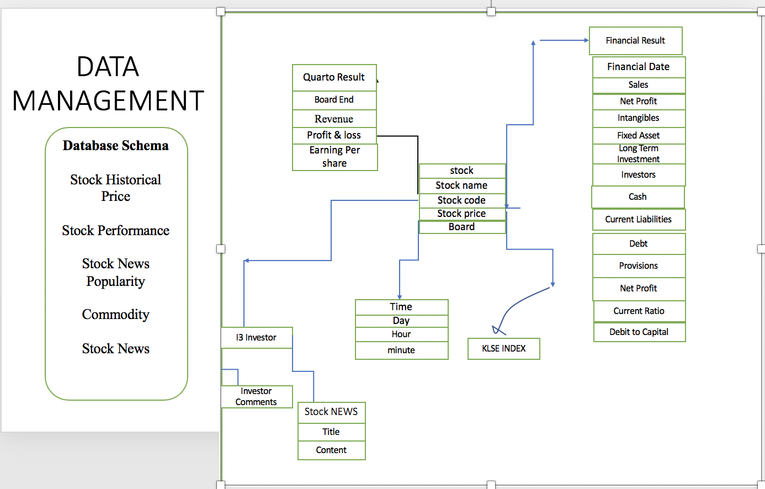
Data scheme

Slide 10
Confusion Matrix
Confusion Matrix
 | Predicted UP= TRUE | Precited UP=FALSE | Proportion
Actual UP=TRUE | 1 | 3 | 4/15=26.67%
Actual UP=FALSE | 9 | 2 | 73.3
Proportion | 10/15=66.67% | 5/15=33.33% | 15

Slide 11
Conclusion
The proposed model investigated the simultaneous effect of analyzing different types of news along with historical numerical attributes for understanding stock market behavior. Our proposal model improved the prediction accuracy for the future trend of stock market, by considering different types of daily news with different values of numeric attributes during a day.

